Slide 1
Strassen's Matrix
Multiplication
Strassen’s matrix multiplication
Dept. Of CSE, RNSIT 2016

Slide 2
Introduction
Strassen’s matrix multiplication
Since the invention of Matrix multiplication, many have strived to improvise the basic algorithm. As numbers and mathematics grew more complex so did the algorithms. Hence there was an increase in the time complexity and decreased efficiencies.
The most common type of algorithms followed basically 3 steps namely, multiply, shift and add. This also requires knowing more multiplication tables even for a single digit.
This lead to invention of new algorithms late in 1800’s.
Dept. Of CSE, RNSIT 2016

Slide 3
Problem Statement
Strassen’s matrix multiplication
To implement the working of STRASSEN’S Matrix Multiplication,
Compare it with the standard matrix multiplication method and Calculate its Time Complexity and Efficiency.
Dept. Of CSE, RNSIT 2016

Slide 4

Basic Matrix Multiplication
Strassen’s matrix multiplication
Suppose we want to multiply two matrices of size N x N: for example A x B = C.
C₁₁ = a₁₁b₁₁ + a₁₂b₂₁
C₁₂ = a₁₁b₁₂ + a₁₂b₂₂
C₂₁ = a₂₁b₁₁ + a₂₂b₂₁
C₂₂ = a₂₁b₁₂ + a₂₂b₂₂
2x2 matrix multiplication can be accomplished in 8 multiplication.
(2^{log}₂⁸ =2³)
Dept. Of CSE, RNSIT 2016

Slide 5
Strassens’s Matrix Multiplication
Strassen’s matrix multiplication
Volker Strassen first published this algorithm in 1969 .
Strassen showed that 2x2 matrix multiplication can be accomplished in 7 multiplication and 18 additions or subtractions. .(2^{log}₂⁷ =2^{2.807})
Where as the standard matrix multiplication accomplishes this task in 8 multiplication and 4 additions.
This reduction can be done by Divide and Conquer Approach.
Dept. Of CSE, RNSIT 2016

Slide 6
Divide-and-Conquer
Strassen’s matrix multiplication
Divide-and conquer is a general algorithm design paradigm:
  Divide: divide the input data S in two or more disjoint subsets S₁, S₂, …
  Recur: solve the sub problems recursively
  Conquer: combine the solutions for S₁, S₂, …, into a solution for S
Analysis can be done using recurrence equations
Dept. Of CSE, RNSIT 2016

Slide 7
Implementation
Strassen’s matrix multiplication
P₁ = (A₁₁+ A₂₂)*(B₁₁+B₂₂)
P₂ = (A₂₁ + A₂₂) * B₁₁
P₃ = A₁₁ * (B₁₂ - B₂₂)
P₄ = A₂₂ * (B₂₁ - B₁₁)
P₅ = (A₁₁ + A₁₂) * B₂₂
P₆ = (A₂₁ - A₁₁) * (B₁₁ + B₁₂)
P₇ = (A₁₂ - A₂₂) * (B₂₁ + B₂₂)
C₁₁ = P₁ + P₄ - P₅ + P₇
C₁₂ = P₃ + P₅
C₂₁ = P₂ + P₄
C₂₂ = P₁ + P₃ - P₂ + P₆
Dept. Of CSE, RNSIT 2016

Slide 8
Comparison
Strassen’s matrix multiplication
C₁₁ = P₁ + P₄ - P₅ + P₇
= (A₁₁+ A₂₂)(B₁₁+B₂₂) + A₂₂ * (B₂₁ - B₁₁) –
(A₁₁ + A₁₂) *B₂₂ +(A₁₂ - A₂₂) * (B₂₁ + B₂₂)
= A₁₁ B₁₁ + A₁₁ B₂₂ + A₂₂ B₁₁ + A₂₂ B₂₂ + A₂₂ B₂₁ – A₂₂ B₁₁ -
A₁₁ B₂₂ -A₁₂ B₂₂ + A₁₂ B₂₁ + A₁₂ B₂₂ – A₂₂ B₂₁ – A₂₂ B₂₂
= A₁₁ B₁₁ + A₁₂ B₂₁
Dept. Of CSE, RNSIT 2016

Slide 9
Time Complexity
Strassen’s matrix multiplication
T(n)= b ; n<=2
7T(n/2)+an² ; n>2
General form : w.k.t f(n)=an²
T(n) = aT(n/b)+f(n) n=b^{k} a=7 , b=2
n=2^{k} k=log₂n
T(n) = 7T(n/2) + an²
= 7[7 T(n/4) + a(n/2)²]+an²
= 7²T(n/4) + 7 a(n/2)² + an²
= 7³ T(n/8) + 7² a(n/4)² + 7 a(n/2)² an²
Dept. Of CSE, RNSIT 2016

Slide 10
Strassen’s matrix multiplication
=7^{k}T(n/2^{k})+7^{k-1}an²/(2^{k-1})²+7^{k-2} an²/(2^{k-2})² +…..+ 7an²/4 + an²
=7^{k}T(n/2^{k}) +an² {7^{k-1} /(4^{k-1})+ 7^{k-2}/(4^{k-2}) + ……………..+7 /4 +1}
= 7^{k}T(1) + an² {1 + 7 /(4) + 7²/(4²) + ……………..+(7 /4)^{k-1}
= cn²(7/4)^{log}₂^{n} + 7 ^{log}₂^{n} , where ‘C’ is a constant
= cn ^{log}₂^{4+ log}₂^{7- log}₂⁴ + n ^{log}₂⁷
= 7 ^{log}₂^{n}
T(n) = O(n ^{log}₂⁷)
T(n) = O(n^{2.81})
Dept. Of CSE, RNSIT 2016

Slide 11
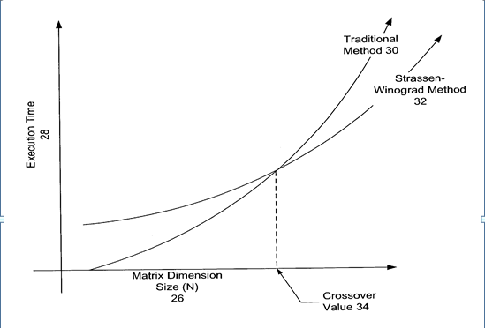
Strassen’s matrix multiplication
Graphical analysis
Dept. Of CSE, RNSIT 2016

Slide 12
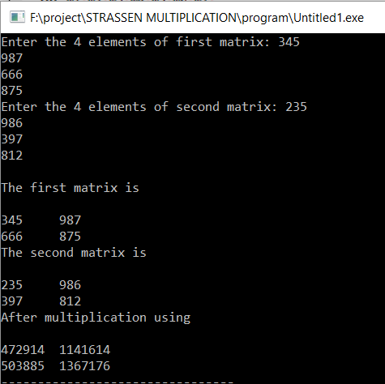
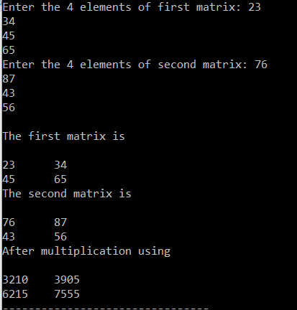
Results
Strassen’s matrix multiplication
The C code was implemented on Turbo C.
Here are some of the results obtained for our algorithm:
Dept. Of CSE, RNSIT 2016

Slide 13
Strassen’s matrix multiplication
Advantages
Strassen’s algorithm adopts the method of recursive algorithms, which is helpful to the implementation and analysis of the algorithm.
Dept. Of CSE, RNSIT 2016

Slide 14
Limitations
Strassen’s matrix multiplication
The biggest drawback of Strassen's matrix multiplication is that it is restricted only for square matrices with even dimensions.
For Sparse matrices, there are better methods especially designed for them.
The sub matrices in recursion take extra space.
Because of the limited precision of computer arithmetic on non integer values, larger errors accumulate in Strassen’s algorithm.
Dept. Of CSE, RNSIT 2016

Slide 15
Russian Peasant’s
Multiplication
Russian Peasant Multiplication
Dept. Of CSE, RNSIT 2016
Notes:
Russian Peasant Multiplication

Slide 16
Introduction
Russian Peasant Multiplication
In mathematics, ancient Egyptian multiplication , one of the multiplication methods used by scribes, was a systematic method for multiplying two numbers that does not require the multiplication table, only the ability to multiply and divide by 2, and to add.
It decomposes one of the multiplicands into a sum of powers of two and creates a table of doublings of the second multiplicand.
This method is called mediation and duplation, where mediation means halving one number and duplation means doubling the other number.
It is still used in some areas.
Dept. Of CSE, RNSIT 2016

Slide 17
Problem Statement
Russian Peasant Multiplication
To implement the working of Russian Peasant’s Multiplication by taking positive integers. Also compare its working with basic multiplication.
Dept. Of CSE, RNSIT 2016

Slide 18
Implementation
Russian Peasant Multiplication
For example, to multiply 238 by 13 , the smaller of the numbers (to reduce the number of steps ) 13, is written on the left and the larger on the right. The left number is progressively halved and the right one is doubled , until the left number is 1. Lines with even numbers on the left column are struck out , and the remaining numbers on the right are added , giving the answer as “3094” : which is the product of 13*238.
13 238
6 476 3 952
1 + 1904
3094
Dept. Of CSE, RNSIT 2016

Slide 19
Algorithm
Russian Peasant Multiplication
ALGORITHM Russian ( P, Q , struct stack x)
// To multiply 2 numbers using Russian peasant`s algorithm
//Input: Two positive numbers P and Q
//Output: product of P and Q
Prod =0
x.top=1
i= x.top
if (P==0) or q==0)
prod =0
else
Dept. Of CSE, RNSIT 2016

Slide 20
while (P>=1)
if( (P%2)!=0)
i++
x.a[i]=q
p=p/2
q=q*2
for (j form 0 to i) do
prod = prod+ x.a[j]
return prod
Dept. Of CSE, RNSIT 2016

Slide 21
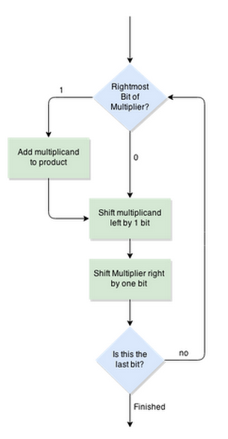
Flowchart
Russian Peasant Multiplication
Dept. Of CSE, RNSIT 2016

Slide 22
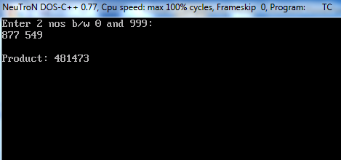
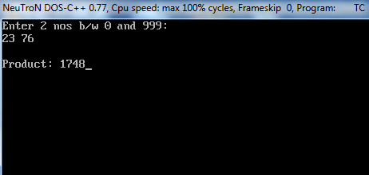
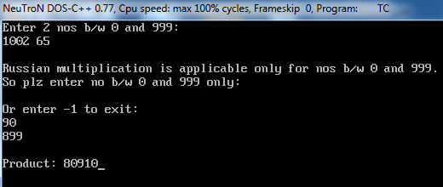
Results
Russian Peasant Multiplication
As evident from the algorithm, for numbers greater than 999 are not applicable for Russian Multiplication.
Here are some of the results obtained for the algorithm:
Dept. Of CSE, RNSIT 2016

Slide 23
Time Complexity
Russian Peasant Multiplication
So compared to the basic multiplication there is a decreased time complexity.
The efficiency of basic multiplication is low compared to this algorithm. The efficiency of this algorithm is more as it involves dividing and summing up the result. Hence the efficiency for this algorithm will be:
O (log2(n))
Efficiency
Dept. Of CSE, RNSIT 2016

Slide 24
Limitations
Russian Peasant Multiplication
Every algorithm has some drawback. The drawback in basic algorithm was its decreased efficiency, which was resolved in the Russian algorithm. This algorithm also have drawback in its implementation. The drawbacks involved are:
Russian Peasant Multiplication method is not applicable for numbers greater than or equal to 1000.
This algorithm will not work for decimals.
Dept. Of CSE, RNSIT 2016

Slide 25
Conclusion
Russian Peasant Multiplication
Although using the MUL instruction may have produced faster and/or smaller code, Russian Peasant multiplication was easier for me to understand and implement. Extending the algorithm for larger multiplicands is very straightforward, this is important to me for future applications. Implementation of the algorithm resulted in a small amount of simple code. The process was also very instructive.
Dept. Of CSE, RNSIT 2016

Slide 26

References:
Dept. Of CSE, RNSIT 2016

Slide 27
Thank U
Russian Peasant Multiplication
Presented By:
Prashanth M
Vinyas R
Praveen M
Hemanth T
Dept. Of CSE, RNSIT 2016

